Slide 1


Predicting Diabetes Risk with Machine Learning
Using health parameters for early detection and preventive healthcare.
by LAVANYA R

Slide 2
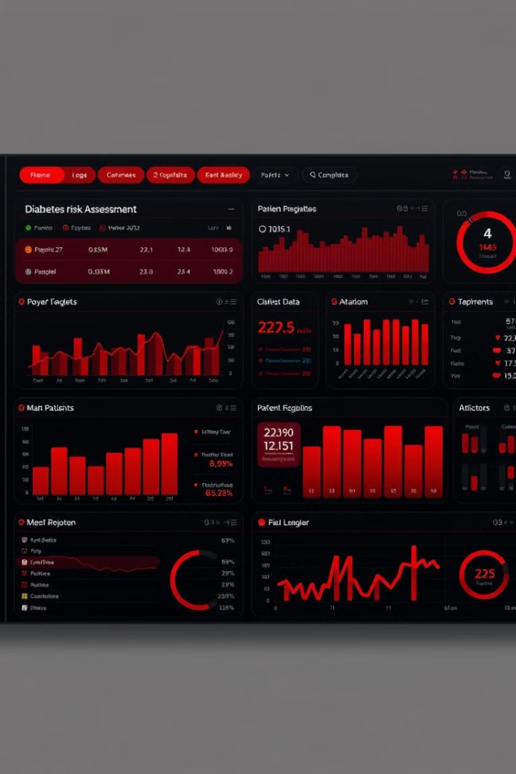
Project Overview
1
ML Model
Predict diabetes risk using key health parameters.
2
Data-Driven
Early detection for preventive decisions.

Slide 3





Key Dataset Features
Glucose Level
Blood Pressure
BMI
Age & Gender

Slide 4




Machine Learning Approach
KNN Algorithm
K-Nearest Neighbors for classification.
Cross-Validation
Fine-tuned to improve performance.
Reduce Overfitting
Ensuring model generalization.

Slide 5
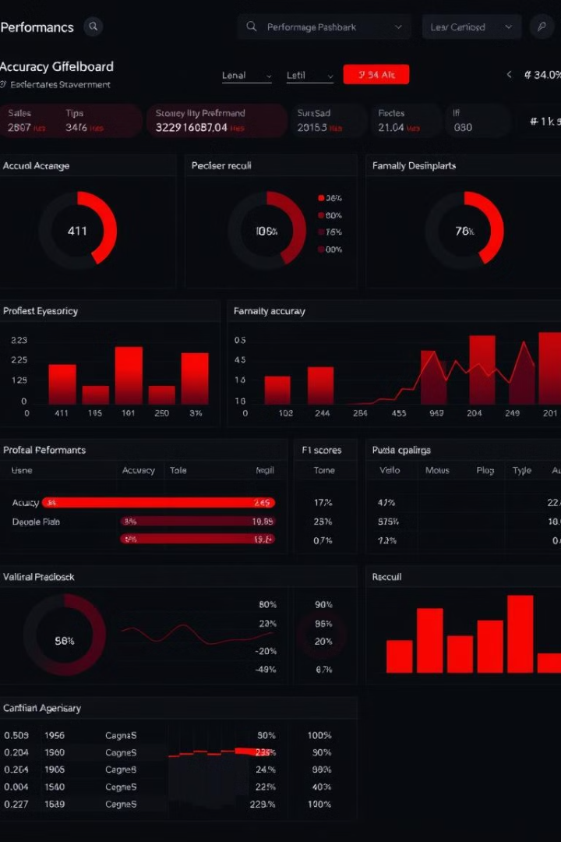
Model Performance
73.47
%
Training Accuracy
70.4
%
Test Accuracy

Slide 6

Evaluation Metrics
Accuracy Score
Confusion Matrix
Precision, Recall, F1-Score

Slide 7
Tools & Technologies
Language
Libraries
Evaluation
Python
Pandas, NumPy, Scikit-Learn
Cross-Validation

Slide 8

Future Enhancements
1
Experiment
Random Forest, XGBoost
2
Feature Engineering
Improve accuracy
3
Deployment
Flask or Streamlit

